Slide 1

Coding Projects Folder Analyzer
Theme: AI-Driven Developer Intelligence
Category: Software
Group No -03
Group Members: Onkar Deshmukh, Prathamesh Kolhe, Bhavika Kadam, Soham Jathar
Guide: Prof. Vijesh Nair

Slide 2
Outline
Introduction
Literature Survey
Limitations of existing systems
Problem statement and Objectives
Proposed Methodology
Experimental Setup
Implementation
Results & Analysis
Conclusion and Future work
References

Slide 3
Introduction
A Coding Projects Folder Analyzer is a tool designed to examine and evaluate the structure and contents of a coding project directory. It scans all files and subfolders within a project to provide insights into organization, file types, code distribution, dependencies, and overall project structure.
This type of analyzer helps developers understand how a project is organized, detect unused or duplicate files, identify missing documentation, and ensure consistent folder naming conventions. It can also generate summary reports highlighting metrics such as total lines of code, number of files by language, and folder hierarchy. Overall, a Coding Projects Folder Analyzer improves project clarity, maintainability, and efficient collaboration.

Slide 4
Literature Survey
Author & Year | Techniques / Methods | Key Points of the Paper | Limitations
Kaur & Singh, 2024 | Structural pattern discovery, source code clustering | Focuses on discovering architectural patterns and hidden dependencies in large codebases using clustering techniques. Helps reveal project structure automatically. | Research-oriented; lacks a practical, user-friendly tool for real developers. Limited visualization support.
Bavota et al., 2022 | Module clustering, graph-based software comprehension | Uses clustering algorithms to improve understanding of complex software systems. Groups related modules to simplify architecture exploration. | Focused only on clustering; does not provide AI explanation or real-time interactive visualization.
Alrashed & Maletic, 2021 | Software visualization, remodularization techniques | Introduces visual methods to explain software architecture and assist in restructuring projects for better maintainability. | Requires expert knowledge to interpret results; not automated for beginner users.

Slide 5
Author & Year | Techniques / Methods | Key Points of the Paper | Limitations
Chen et al., 2021 | Code annotation visualization, structural mapping | Provides visual tools to explore relationships between files and code annotations, improving readability. | Does not rank file importance or generate summaries; limited analytical depth.
Haiduc et al., 2018 | Feature maps, semantic software representation | Maps code features to functional behavior for better comprehension of large systems. Enhances semantic understanding of software. | Struggles with scalability on very large projects; lacks dependency ranking and automation.

Slide 6
Limitation in Existing systems:
Most tools focus on code quality and metrics, not on folder structure analysis.
Limited support for multiple programming languages.
Lack of understanding of project organization and context.
Inability to detect unused or redundant files effectively.
Provide basic visualization without detailed structural insights.
Require manual configuration and lack automated recommendations.
.

Slide 7
Problem statement and Objectives
In software development, project folders often become disorganized due to continuous updates, multiple contributors, and lack of standardized structure. Existing tools primarily focus on code quality, metrics, or performance analysis, but they do not adequately analyze the overall folder organization and structural consistency of coding projects.
As a result, developers face difficulties in understanding project layout, identifying redundant or unused files, and maintaining proper naming conventions. This leads to reduced productivity, poor maintainability, and challenges in collaboration

Slide 8
Objectives:
To scan and analyze all files and subfolders within a coding project directory.
To categorize files based on type, language, or purpose.
To generate reports on folder hierarchy, file count, and code distribution.
To detect duplicate, unused, or improperly placed files
To evaluate adherence to predefined organizational standards.
To provide suggestions for improving project structure and maintainability.

Slide 9
Proposed Methodology
The Coding Projects Folder Analyzer automatically scans project directories, analyzes folder structure, and generates reports with issues and improvement suggestions. It consists of a UI for folder selection, a Folder Scanner using DFS to collect file metadata, a Structure Analyzer to calculate metrics like file count and folder depth, a Rule Engine to validate naming conventions and detect duplicates, and a Report Generator to present results. Optionally, a database stores analysis history. Unlike existing tools, it focuses on folder organization, supports multi-language projects, and provides actionable suggestions to improve maintainability and collaboration.

Slide 10
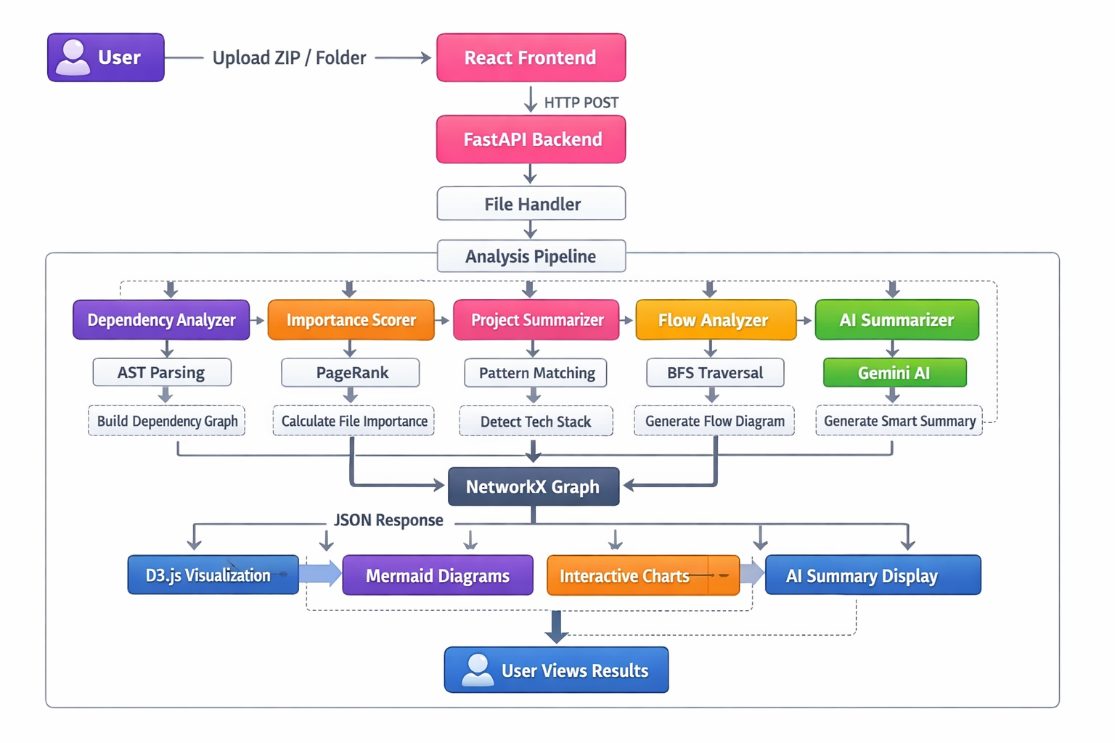
Architecture Diagram:

Slide 11
Experimental Setup:
Frontend :
-React.
-Vite.
- Mermaid.js : Flowchart generation.
Backend :
-Python.
-Uvicorn : ASGI web server.
-NetworkX : Graph algorithms & PageRank.
Algorithms :
-AST Parsing : Python code structure analysis.
-PageRank : File importance calculation.
-BFS Traversal : Execution flow mapping.
-Force-Directed Layout : D3.js graph positioning.
-Pattern Matching : Framework detection.

Slide 12
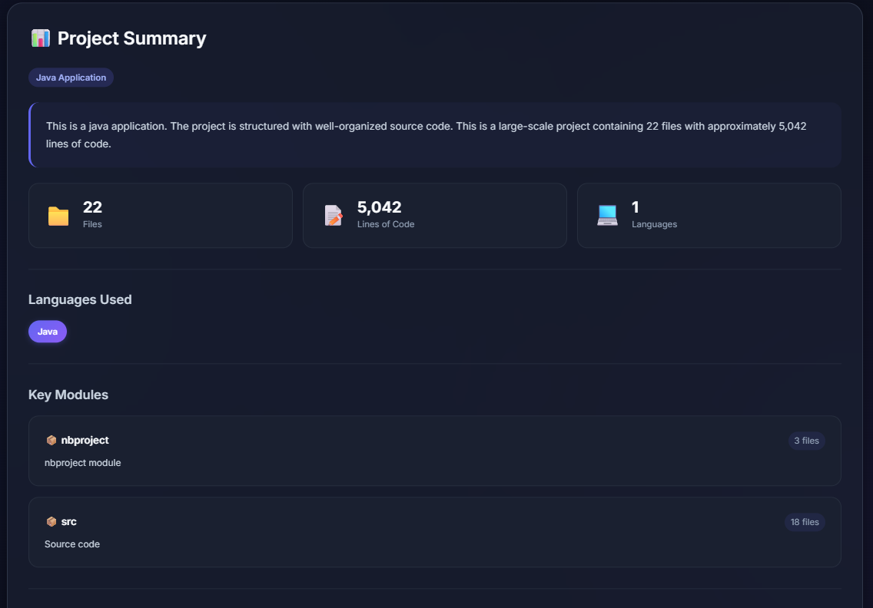
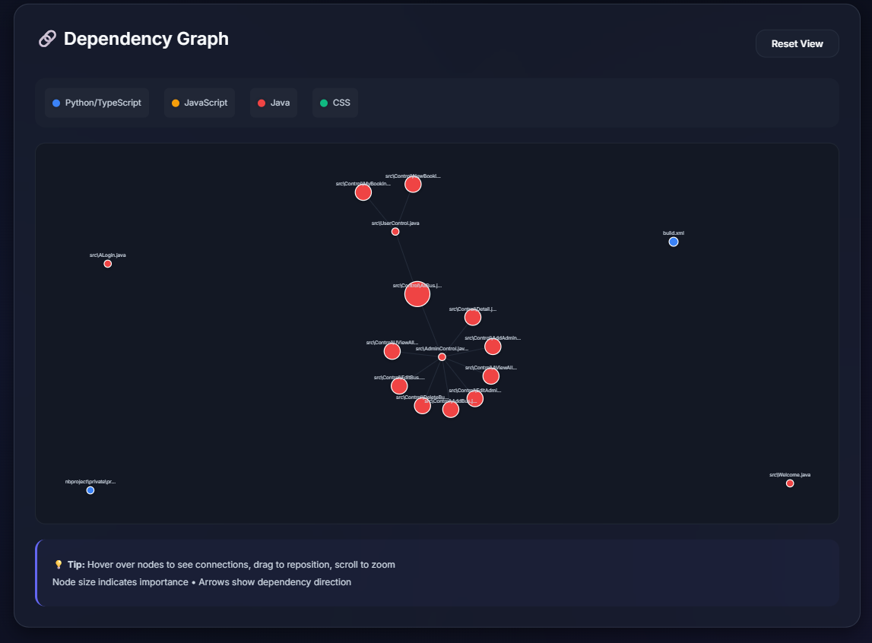
Implementation

Slide 13
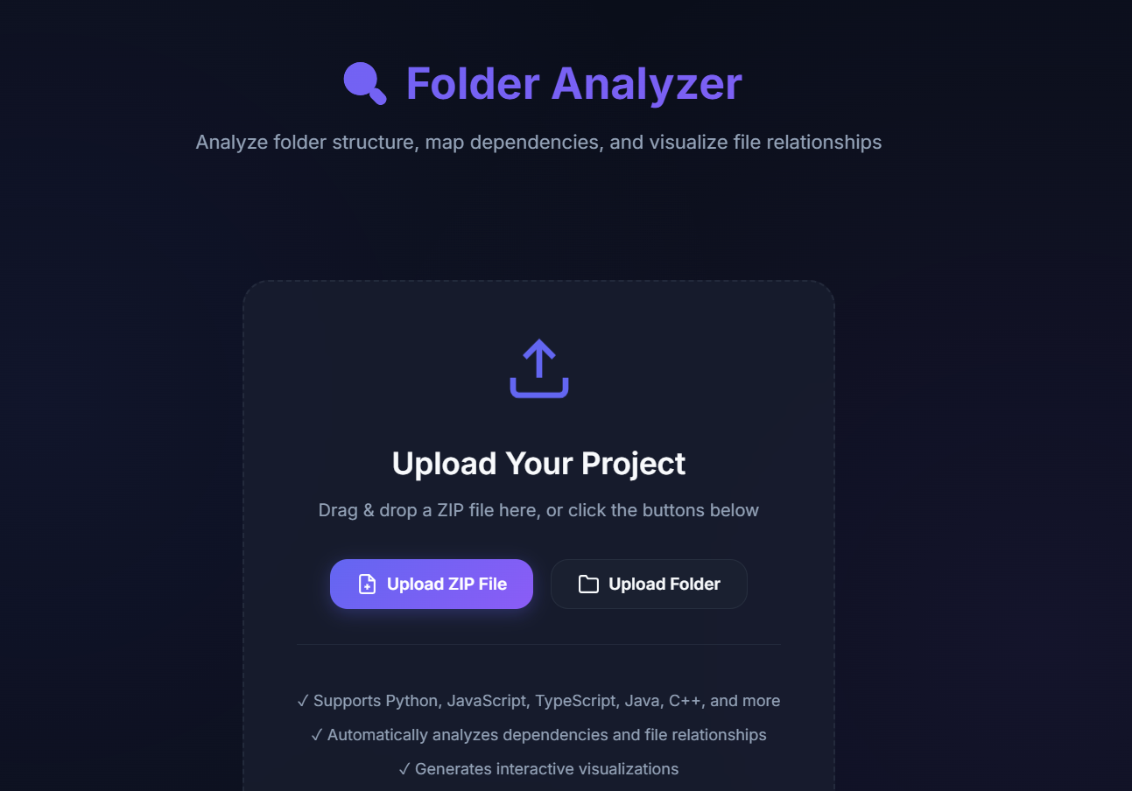
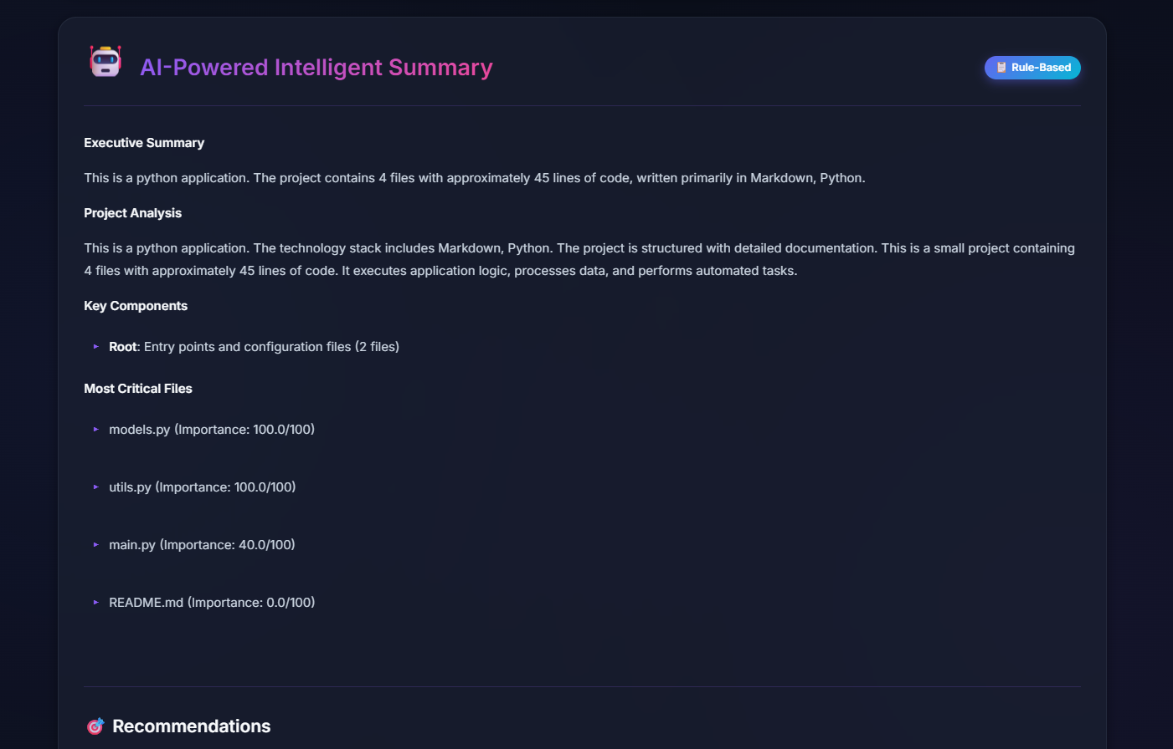

Slide 14
Conclusion
The Coding Project Folder Analyzer automates the understanding of large codebases by analyzing structure, dependencies, and file importance. It reduces manual effort and speeds up developer onboarding.
By combining visualization and intelligent analysis, the system improves productivity, maintainability, and project navigation. It highlights how AI-driven tools can simplify modern software development.

Slide 15
Future Scope
Integration with GitHub and other remote repositories
Real-time monitoring of project changes
AI-based refactoring and optimization suggestions
IDE plugin support (VS Code / IntelliJ)
Automated documentation generation
Support for large enterprise-scale projects

Slide 16
References
Program Source Code Comprehension by Module Clustering. https://doi.org/10.1016/j.advengsoft.2022.103252
E-SC4R: Explaining Software Clustering for Remodularisation. https://arxiv.org/abs/2107.01766
CADV: Software Visualization for Code Annotations. https://arxiv.org/abs/2112.10938
Feature Maps: Comprehensible Software Representation. https://arxiv.org/abs/1812.09873
Clustering Source Code for Structural Pattern Discovery. https://link.springer.com/article/10.1007/s41060-024-00554-5

Slide 17
Thank You...!!

